Slide 1
XCIST simulation & recon tests: XCAT phantom (male head section), vary detectorColSize and viewsPerRotation

Slide 2
Voxelized XCAT phantom experiments
Scanner
vary focal spot width
vary detector column width
vary number of columns for 48-cm detector (267-mm FOV)
1 detector row
¼-detector column offset
Physics
120 kV
Quantum noise on
Electronic noise on
Electronic noise on
Scatter off
vary source sampling
vary detector sampling
vary view sampling
Protocol
1-s rotation
vary mA
vary views/rotation
Phantom
XCAT vmale_50_phantom, Zoffset -431 mm (to head)
Recon
1 slice
0.568-mm slice thickness (native)
260-mm FOV
No offset
Bone kernel
HU

Slide 3
Voxelized XCAT phantom experiments
Scanner
vary focal spot width
vary detector column width
vary number of columns for 48-cm detector (267-mm FOV)
1 detector row
¼-detector column offset
Physics
120 kV
Quantum noise on
Electronic noise on
Electronic noise on
Scatter off
vary source sampling
vary detector sampling
vary view sampling
Protocol
1-s rotation
vary mA
vary views/rotation
Phantom
XCAT vmale_50_phantom, Zoffset -431 mm (to head)
Recon
1 slice
0.568-mm slice thickness (native)
260-mm FOV
No offset
Bone kernel
HU

Slide 4
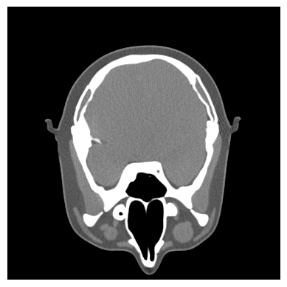




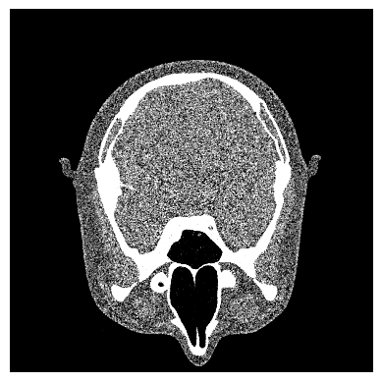



2-mm det. col.
1-mm det. col.
0.25-mm det. col.
2-mm focal spot
1-mm focal spot
0.25-mm focal spot

Slide 5
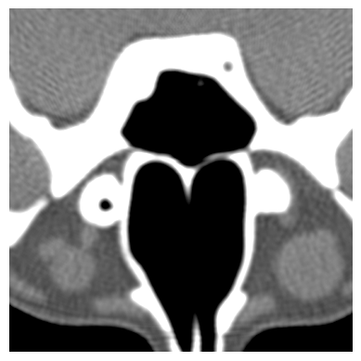
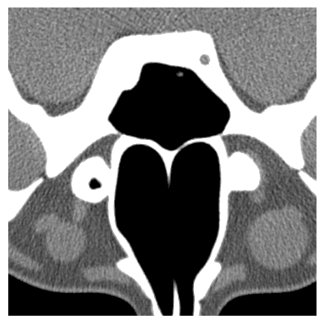







2-mm det. col.
1-mm det. col.
0.25-mm det. col.
2-mm focal spot
1-mm focal spot
0.25-mm focal spot

Slide 6
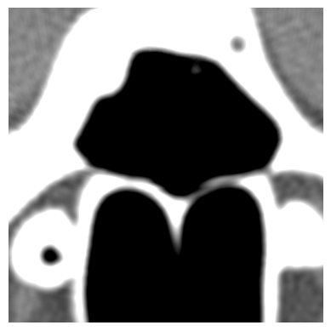

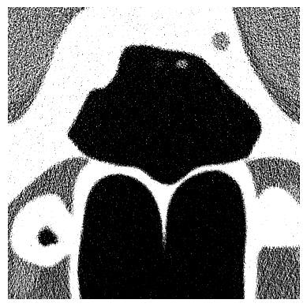

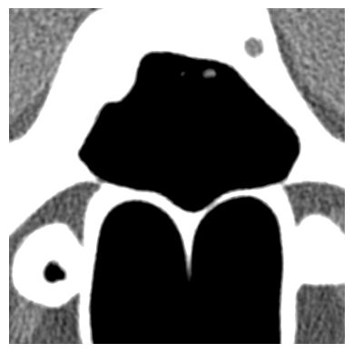




2-mm det. col.
1-mm det. col.
0.25-mm det. col.
1-mm det. col., 1-mm focal spot
2-mm focal spot
1-mm focal spot
0.25-mm focal spot

Slide 7




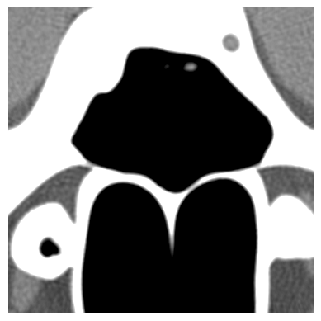

1-mm det. col., 1-mm focal spot
2-mm det. col.
1-mm det. col.
0.25-mm det. col.
4-mm focal spot
0.25-mm focal spot

